Slide 1


COE420 Software Engineering Lab
Welcome!
Lab instructor: Hend ElGhazaly
Summer 2020

Slide 2

If you have any question during the presentation please use the mic or send it in the chat and I will see them at the end…

Slide 3
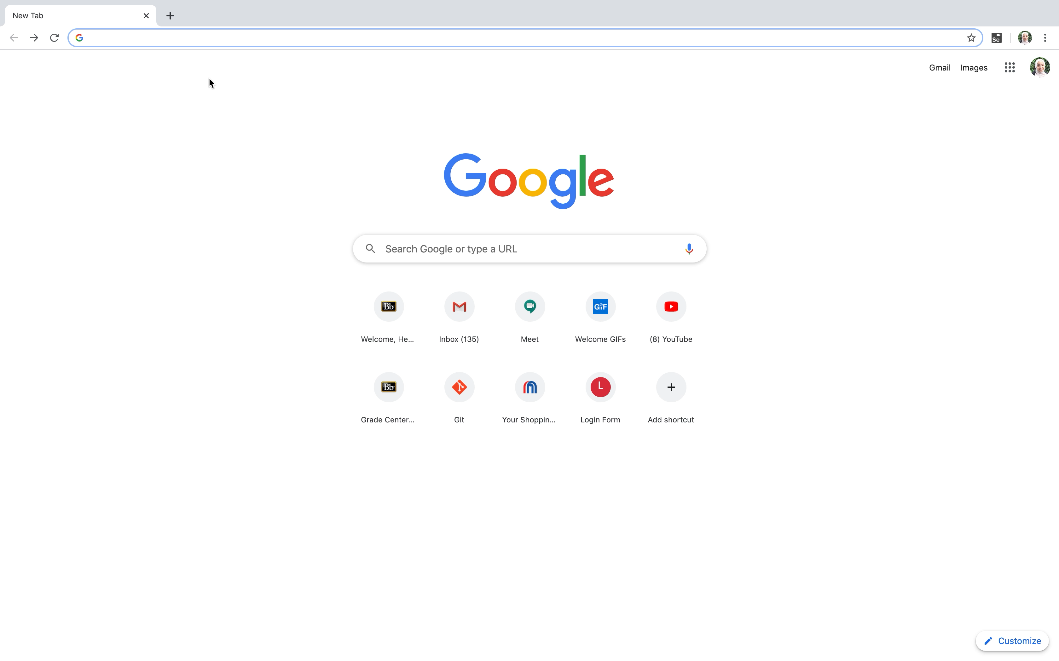
Slido – Code event COE420
https://www.sli.do
Will be used in lab sessions for participation

Slide 4

About Me
Hend ElGhazaly
Joined AUS in Fall 2019.
MSc in Advanced Computer Science from the University of Sheffield with a Distinction classification.
Dissertation on creating the first Arabic Talking Head for Dementia diagnosis.
Presented research in various conferences and awarded prizes
BSc in ITMB (Computer Science and Management) from the University of Sheffield with a First classification.

Slide 5
Logistics
11 labs
Monday and Wednesday at 1:15pm
Online on Blackboard Collaborate
Attendance
compulsory (15% rule)
CSE Attendance mobile app

Slide 6


Contact Details
Email: helghazaly@aus.edu
Virtual Office Hours:
Sunday - Thursday from 3 to 4
Link to join on iLearn
Discussion forums:
Optionally to post your questions

Slide 7
About the labs
Industrial tools introduced in labs to apply the concepts covered in lectures.
Applicable to your course project.
How it will work?
I will explain the tool and concept during the lab session.
Assignments to be completed as homework.
You need to be active during the lab by answering questions, starting on the assignments…
Ask on Collaborate or create google meet sessions so I can assist you individually during the lab.
Random picker will be used and if your name is picked you will be asked to share your screen
Failing to respond will mean that you are absent ☺

Slide 8
Lab Assignments
20% of the course
Posted on iLearn in Assignments folder
Deadline next day 11:59pm
Work in pairs/individual/group depends on topic (mostly individual)
No labs dropped

Slide 9
Policies
5% penalty per day on late submissions, up to 5 days
General grading rubric: implementation of the required, correctness of solution, use of tool, compliance with instructions
Copying is strictly prohibitied
iLearn Tour

Slide 10
I agree to the terms & conditions
Answer on Slido (event code: COE420)

Slide 11

Lab Schedule:
Version control
Project management
UML Models
GUI
Databases
Implementation
Testing
Topics
4
5
6
7
8
Lab #
1
2
3
9
10
11
Component and Node Diagram
State Machines
Class Diagram
Use Case Diagram
Sequence Diagram
You are here
15th July

Slide 12



Student of the Week
Active participation during the lab, coming to lab on time, submitting on time.
Prize: recognition and +1 on lowest lab
Different student awarded every week
Announced at the beginning of Monday’s lab
Starting from next week ☺

Slide 13
Lab 1: Version Control
Git and GitHub

Slide 14
Today’s Lab
Introduction to version control.
Using Git and GitHub to version control the software under production.
Creating GitHub accounts, organization, repository.
Pushing and pulling versions to the remote directories using Git and GitHub.

Slide 15
Q Anyone used Git or GitHub before?
Yes
No
Slido Event Code COE420

Slide 16
Version Control
What it is and its benefits

Slide 17
What is Version Control?
A system that records changes or versions of file/s over time.
Benefits of Version Control
Revert to older version of code
Helps developer teams work on different components of a software concurrently and allows integration of these components
See who last modified something that might be causing a problem
Recover lost files
Ensures no code conflicts occur between developers

Slide 18
Git
What is it and how to use it

Slide 19
What is Git?
Industry standard
Distributed Version control system
Keeps history of your code
Track changes in files or projects
pull
push
push
pull
Distributed Version Control
Source: Pro Git Book

Slide 20
Terminology in git
Repository: container, directory, project folder
Local repository – stored on your own computer, local version of the code
Remote repository – stored on a remote server, useful when working with teams
Commit: snapshot of code at a particular time
Branch: individual timelines or alternative environments

Slide 21
How to use Git
Step 1: Install Git from here
If you want to integrate Git with your editor check this link or this link
Step 2: Configure your details (name & email)
To track who made what changes
Step 3: initialize repository
Step 4: check status
Check the status of the repository to see which files were changed, staged, untracked
Step 5: add files to staging area
The changed files that you want to track and commit
Step 6: commit changes
To save the changes in the repisotry
Tip: make small commits (after every feature added or changed or bug fixes)

Slide 22
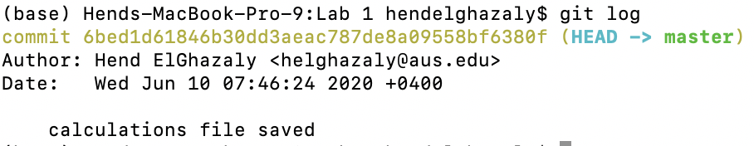
Git commands
git status
To check the status
git add filename
To add changed files to staging area
git commit –m “message”
To commit changes
git log
Views commit history
git checkout <commit-hash>
Revert to previous version

Slide 23
Branching
Branches like timelines.
Useful if you want to try somethings but do not want to impact the main one.
For example if you are unsure about a certain feature you added so you wan to show them first to team members.
By default, we initially use the Master branch (main one).
You can create new branches.
Merge with master:
git merge branchName

Slide 24
Demo using Git
Initializing a git repository, staging and committing

Slide 25
Q: What should be done first before committing changes?
Pushing changes to local repository
Viewing all previous commits made
Adding the changed files to the staging area
Slido Event Code COE420

Slide 26
GitHub
What is it and how to use it

Slide 27
What is GitHub?
Platform to share and collaborate on code
Access remote repository
To share your code (local repository) with others (team members)
Notes:
Developers will use their local repository but will need to push to remote repository for the other developers to see the updated code

Slide 28
Terminology
Organization: shared account where the team members collaborate
Clone: downloading the repository to your local machine
Pull: pull requests allows you to view any changes made
Push: updates a remote branch with the commits (changes) made

Slide 29
How to use GitHub?
Create an account.
Create an organization with your team members.
Create a repository for your team project.
Add/commit your code locally using Git.
Push your code to GitHub.

Slide 30
Demo using GitHub
Creating organization, repository, viewing commits, issues

Slide 31
Q: What is GitHub?
Command-line tool
Git repository hosting service
Integrated Development Environment (IDE)
Operating System
Slido Event Code COE420

Slide 32
Git vs GitHub
Git is an open-source tool developers install locally to manage source code, while GitHub is an online service to which developers who use Git can connect and upload or download resources.
Git is the main tool, you can use it on its own.
GitHub relies on Git, allows you to share your repository with others.

Slide 33
Summary
Create team repo on GitHub
Push to GitHub repo
add changed files to staging area
commit changes
Create local git repo
push to remote repository
Or clone team repo
Pull latest version
git add .
git commit -m “message”
git push origin master

Slide 34
Lab Execise
Assignment document and code file on iLearn

Slide 35




For today’s lab exercises…
Scenario: 4 team members working on a software project
Member_A
Member_B
Member_C
Member_D
Decide now on your team

Slide 36
What you will need in this lab:
Git (install it or add extension in VS Code or Atom)
GitHub account
If needed, Google meet session with your team members to communicate

Slide 37
Your tasks:
Exercise 1: Install Git (all team members)
Exercise 2: Create accounts, organization and repository on GitHub (all team members)
Exercise 3: Configure your details (all team members)
Exercise 4-5: Pushing initial commit (member_A only)
Exercise 6: Pushing changes (member_B, member_C, member_D)
Exercise 7: Getting Updated Version (all team members)

Slide 38
Have you picked your team?
poll
One team member send in the chat the names of the team members
You will see the assignment link by the end of the lab session (after I enroll you in groups)

Slide 39
Create an account on GitHub
Create an organization and invite team members
Create a repository for the project
Make the initial commit
Pull updated version
Member_A

Slide 40
Create an account on GitHub
Join organization
Add features to the java program
Commit changes
Pull updated version
Member_B
Member_C
Member_D

Slide 41
What to Submit:
Report with screenshots
Follow the template provided for the report submission
Only one team member needs to submit the report
Deadline Tomorrow (Thursday 11th June 11:59pm)

Slide 42
In the next 30 minutes…
Start on the lab exercises:
Form team
Install Git
Create GitHub accounts
The rest to be completed as homework and submitted by tomorrow midnight
Send me the links to the Google meet sessions in the chat
Will pick a student at random to share their screen ☺

Slide 43
One team member send in the chat the names of the team members Send Google meet sessions and work on exercises…

Slide 44
Summary – What we covered today
Introduction to version control
Using Git and GitHub
Create accounts, organization and a repository for the team on GitHub
Use Git to pull, push and commit changes to a java program
For any questions, email me or join the virtual office hour everyday at 3pm

Slide 45
Userful Resources:
Git documentation: https://git-scm.com/doc
About GitHub: https://guides.github.com/
Pro Git Book: https://git-scm.com/book/en/v2
Useful tutorial on Git: https://www.freecodecamp.org/news/what-is-git-and-how-to-use-it-c341b049ae61/

Slide 46
Deadline Tomorrow (Thursday 11th June 11:59pm)

Slide 47


